Slide 1
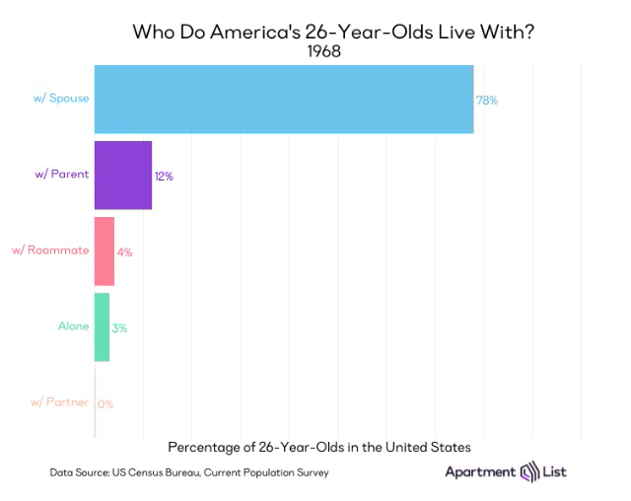

Slide 2

2018 Home and Community Preferences Survey: A National Survey of Adults Age 18-plus
October 2019
Notes:
Photo credit: iStock.com/ violetkaipa

Slide 3
Preference to stay in their own community and residence is higher in older generations.
“What I’d really like to do is remain in my community for as long as possible.”
“What I’d really like to do is stay in my current residence for as long as possible.”
92%
68%
76%
68%
58%
Q1: How strongly do you agree or disagree with the statement: What I’d really like to do is remain in my community for as long as possible? Q2: How strongly do you agree or disagree with the statement: What I’d really like to do is stay in my current residence for as long as possible?
Notes:
Of the people that want to stay in their community, 84% want to stay in their current residences.
2. 63% own and 27% rent. Older generations are more likely to own their residences, while younger generations are more likely to rent; Generation Z is most likely to live with family or others. Hispanics and African Americans are also less likely to be home owners.
This sentiment is of course is much less intense for renters overall:
Stay in community (75% owners vs 57% of renters)
Stay in home (75% owners vs 44% of renters)
3. Preference to stay in their home and community is similar across race and ethnicity.
4. No differences across reported disability status.
5. No real differences across income groups. (<$25K; $25K-$49.9K; $50K-$74.9K; $75K+).

Slide 4
Preference to stay in their own residence is lower among California residents.
“What I’d really like to do is remain in my community for as long as possible.”
“What I’d really like to do is stay in my current residence for as long as possible.”
68%
Q1: How strongly do you agree or disagree with the statement: What I’d really like to do is remain in my community for as long as possible? Q2: How strongly do you agree or disagree with the statement: What I’d really like to do is stay in my current residence for as long as possible?
Notes:
CA residents are a little less likely to say they want to stay in their current residence for as long as possible (54% vs 64%).
CA residents are much MORE likely to be renters (40% vs 26%).
CA residents are much LESS likely to be home owners (48% vs 64%).
This sentiment is less for renters than home owners in California but not significant due to small sample size.

Slide 5
Younger generations are more likely to move to a different community compared to older generations which are more likely to stay in their current residence.
Q3: Thinking about your future years are you more likely to move to a different community, move into a different residence within your current community or stay in your current residence and never move?
Notes:
About a third of all adults say they will need to make some changes to their current home in order to be able to stay there and this is slightly higher [although no significant] for Baby Boomers. With regards to necessary home improvements this is not the case for the Silent generation which is expected because they are already living in their current housing situation whether it is appropriate for them or not.
The most common changes are bathroom modifications and easier access into or within the home. Think ramps, wider doorways, etc.
2. Owners vs Renters:
Move to a different community (25% owners vs 40% of renters)
Move to a different home within community (15% owners vs 27% of renters)
Stay in current residence (46% owners vs 17% of renters)
3. No real differences across race/ethnicity.
4. No differences across reported disability status.
5. No differences across income groups.

Slide 6
California residents are much less likely to stay in their current residence.
Q3: Thinking about your future years are you more likely to move to a different community, move into a different residence within your current community or stay in your current residence and never move?
Notes:
Here again, CA residents are less likely to say they would stay in their current residence and is also true for renters.

Slide 7
Few currently have accessory dwelling units; however, a third would consider building one.
An Accessory Dwelling Unit, or ADU, is a residential unit built on the same lot as an existing single family home and may be attached or detached to the home. It can be commonly referred to as a “granny flat” or “in-law quarters.” ADUs provide complete separate living quarters, including a kitchen and bathroom, that can allow older adults to age in their existing home with live-in care, make it possible for adults to assist their aging parents, other relatives and loved ones, or be used for rental income.
1 in 3
would consider building an ADU on their property
7%
Have an Accessory Dwelling Unit
Q9: Do you currently have an ADU on your property? Q10: [Respondents who do not have an ADU on their property.] If you had the space to create an ADU within your home or on your property, would you consider doing that?
Notes:
ADU Presence:
1-6. Presence of an ADU is low regardless of generation, home ownership status, race and ethnicity, disability status, income, and California residency.
Likelihood of building an ADU:
1. Consideration for building an ADU is similar across generations Y, X, and Baby Boomers. Generation Z and the Silent generations were less likely to consider building an ADU; however, this difference is not significant.
2. No differences across home ownership status for building an ADU.
3. Hispanic adults are more willing to build an ADU onto their property.
4. No differences across reported disability status.
5. No differences across income groups.
6. No difference in the likelihood of building one for CA residents.

Slide 8
Adults who have or would consider building an ADU are most willing to build to provide space for those they care about.
Q11: [Respondents who have an ADU on their property or would consider building an ADU on their property.] For each of the following reasons choose whether each one is a major reason, a minor reason, or not a reason for building an ADU on your property.
Notes:
1. Reasons for considering building an ADU are similar across generations Y, X, and Baby Boomers. Generation Z and the Silent generations were less likely to consider building an ADU for a loved one needing care.
Interestingly, Baby Boomers and Silent generations were less like to consider an ADU as an option for providing a home for family or friends.
2. *Reasons differ for owners vs renters:
Much more likely to build for:
Extra income (21% vs 41%)
Increase value of home (27% vs 45%)
To have someone living close by (31% vs 46%)
3. No differences across race and ethnicity; providing a home for a loved one who needs care is the top reason regardless of race and ethnicity.
4. Those reporting no disability are more likely to build an ADU to provide a home for family or friends (41% vs 61%)
5. Those with income of less than $25K are less likely to say they would build an ADU for a loved one who needs care.

Slide 9
California residents are more likely to build an ADU for financial gain and less likely to build one to care for a loved one.
Q11: [Respondents who have an ADU on their property or would consider building an ADU on their property.] For each of the following reasons choose whether each one is a major reason, a minor reason, or not a reason for building an ADU on your property.
Notes:
Photo credit: iStock.com/ tobiasjo
CA residents are much more likely to build an ADU for:
Have a place for a loved one who needs care (54% vs 70%)
Extra income (41% vs 25%)

Slide 10
Generation Y, X and Baby Boomers are more likely to live in an ADU if they needed help or to live close by to someone. Silent generation is least likely to live in an ADU to lower housing costs
Q13: Would you consider living in an ADU…? To lower your housing costs; If you needed help with everyday activities such as household chores or transportation to places like the grocery store or doctor’s office; To live close by to someone but still live in your own separate space.
Notes:
2. Renters much more likely to give income as a reason but are just as likely to choose other reasons as home owners.
*Reasons differ for owners vs renters:
Live in an ADU for:
Renters more likely to live in an ADU to lower their housing costs (49% vs 65%)
3. White and Hispanic adults are more likely to say they would consider living in an ADU if they needed help.
4. No differences across reported disability status.
5. Those with incomes of $75,000+ are more likely to consider living in an ADU if they needed help with daily activities or to live close by but in their own separate place (70% and 75%).

Slide 11
California residents are most likely to live in an ADU to lower housing costs.
Q13: Would you consider living in an ADU…? To lower your housing costs; If you needed help with everyday activities such as household chores or transportation to places like the grocery store or doctor’s office; To live close by to someone but still live in your own separate space.
Notes:
Photo credit: iStock.com/ tobiasjo
CA residents much more likely to live in an ADU to lower their housing costs (68% vs 53%).

Slide 12
Generation Y, X and Baby Boomers are more likely to consider home sharing. Although more Gen Z report being unsure, it is not a statistically significant difference.
Q14: As you grow older would you consider sharing your home with another person?
Notes:
Individuals who are disabled are less likely to consider sharing a home for extra income than those who are not (29.7% vs. 53.3%).
2. No differences among owners and renters.
3. Consideration for home sharing is similar across race/ethnicity.
4. No differences across reported disability status.
5.No differences across income groups.
6. Consideration for home sharing is similar between CA residents and residents of all other states.

Slide 13
Reasons for considering home sharing are actually similar across generations even though there appear to be some differences, they are not a statistically significant.
Q15: [Respondents who are unsure or indicate they would not consider sharing their home] Would sharing your home with another person be something you would consider if…? You needed extra income; You needed help with everyday activities such as household chores or transportation to places like the grocery store or doctor’s office; You found yourself not wanting to live alone and wanting companionship.
Notes:
2. There are no differences across owners and renters.
3. White adults are more like to consider home sharing if they needed help (62% vs 49% (AA) & 52% (H)).
4. Those reporting no disability are much more likely to consider home sharing for extra income (52% vs 36%).
5. There are no differences across income groups.
6. Reasons for considering home sharing is similar between CA residents and residents of all other states.

Slide 14
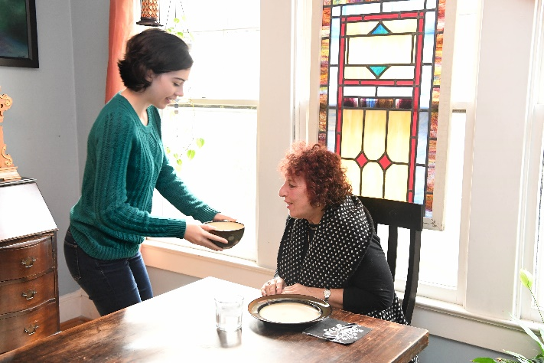
A "village" is a community-based, non-profit, member organization dedicated to doing what is needed for people to stay in their own homes independently as they age. For a fee, a village gives members access to social and educational activities, health and wellness programs, trustworthy businesses for outside services, medical services, volunteer services and transportation to help members stay in their home.
Notes:
Photo credit: Jim Burger

Slide 15
Interest in joining a village and willingness to pay a fee are similar across generations.
“How willing would you be to pay an annual fee based on income for access to services offered through a village organization?”
“How interested would you be in joining a village in your area?”
52%
54%
55%
45%
Q28: How interested would you be in joining a village in your area? Q29: How willing would you be to pay an annual fee based on income for access to services offered through a village organization?
Notes:
There are no differences for individuals who want to stay in their current residence and interest in villages/willingness to pay a fee.
1. Even though it looks like the Silent Generation is less interested and willing, this difference is not statistically significant.
2. Renters are more interested in joining a village than homeowners (52% vs 62%).
3. African American and Hispanic adults are more interested in joining a village and are more willing to pay a fee (76%, 66% vs 48%) & (65%, 64% vs 45%).
4. Those reporting a disability are more likely than those not reporting a disability to be willing to pay a fee to join a village (61% vs 50%)
5. Interest in joining a village is lowest in adults with income between $50,000 and $74,999 (48% vs about 60% for lower income groups.); willingness to pay an annual fee is similar across income levels.

Slide 16
California residents have a higher level of interest in joining a village.
“How willing would you be to pay an annual fee based on income for access to services offered through a village organization?”
“How interested would you be in joining a village in your area?”
Q28: How interested would you be in joining a village in your area? Q29: How willing would you be to pay an annual fee based on income for access to services offered through a village organization?
Notes:
CA residents are more interested in joining a village than residents in other states (65% vs 54%).

Slide 17
Top Important Community Features (%Extremely/Very Important)
88%
Streets & Sidewalks
Well-maintained streets
87%
Well-maintained hospitals and health care facilities
83%
Safe Parks
82%
Conveniently located hospitals and health care facilities
82%
Easy to read traffic signs
Q27: How important is it to you personally to have the following in your community right now?
Notes:
The most important community features, viewed by all adults, are:
1. well-maintained streets
2. well-maintained hospitals
3. safe parks
4. conveniently located hospitals and health care facilities
5. easy to read traffic signs
These did not really vary by age. Other ones that were mentioned just after top 5 are conveniently located grocery stores and streets that are well-lit, safe and accessible for all users.
When think about it, these are all things that makes staying in one’s community easier and plausible. At present most of our research shows that most people drive to get around their communities so having infrastructure to support continued driving is important. Having good health care facilities is also important especially as people age and will consume more health services. Having good public spaces like safe parks is also something that will enhance community life and lead to people staying actively engaged in community life.
So what we know is that most older adults want and intentionally plan to stay in their homes and communities as they age. Because this is so important to them, many are willing to consider housing options like ADUs, home sharing and villages as ways to help them age the way they choose.
We also know that ADUs and home sharing are most appealing to people if they needed help with activities of daily living or be close to people. Generations Y, X, and Baby Boomers give more consideration to ADUs for these reasons. About half of adults would consider becoming part of a village regardless of age.
California residents are a little less likely to want to age in their current homes. They are more likely to consider alternate housing arrangements like ADUs or home sharing for economic reasons and they are also more willing to consider a village model.

Slide 18
Joanne Binette, AARP Research
jbinette@aarp.org
For media inquiries, please contact media@aarp.org
This deck, annotated survey, infographics and methodology report can be accessed at www.aarp.org/livablesurvey2018.
Notes:
Gen Z 1995-2000 18-23
Gen Y 1980-1994 24-38
Gen X 1965-1979 39-53
Baby Boomers 1946-1964 54-72
The Silent Generation 1925-1945 73-93
In the survey we asked about:
Streets & sidewalks
Transportation
Outdoor Spaces & Buildings
Housing
Social Participation
Volunteering
Employment
Health & Wellness but asked under Outdoor Spaces & Buildings
Housing:
73% Home modification & repair contractors who are trustworthy, affordable and reliable
60% Affordable Housing
59% Home repair services for low-income and older adults
56% Well-maintained homes and properties
54% Seasonal services (lawn care and snow removal)
54% Homes built for easier access into and within
Transportation:
60% Safe public transportation that is accessible to all regardless of ability
59% Timely public transportation
58% Well-maintained public transportation
58% Special transportation for people with disabilities and older adults
48% Public transportation that is close to home

Slide 19
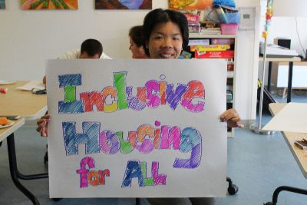
Organizing to Meet the Housing Needs of
San Mateo County Residents
with Intellectual and Developmental Disabilities

Slide 20
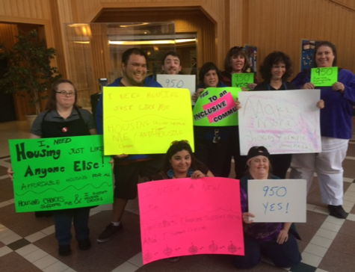
Who Are We Organizing?
Notes:
San Mateo County is home to almost 4,000 people with developmental disabilities, more than two-thirds of whom are adults. These are people with autism, epilepsy, down syndrome, intellectual disability and other disabilities similar in effect to intellectual disability. They are eligible to receive supportive services from the Golden Gate Regional Center when
The disability manifested before the age of 18.
The disability severely impairs at least 3 of 7 areas of daily functioning.
The disability is likely to be lifelong.
The disability will require a coordinated program of supportive services in order for the person to live in the community.
The people we organize have an entitlement to SERVICES to live in the community but without access to affordable housing, that is an empty promise.

Slide 21
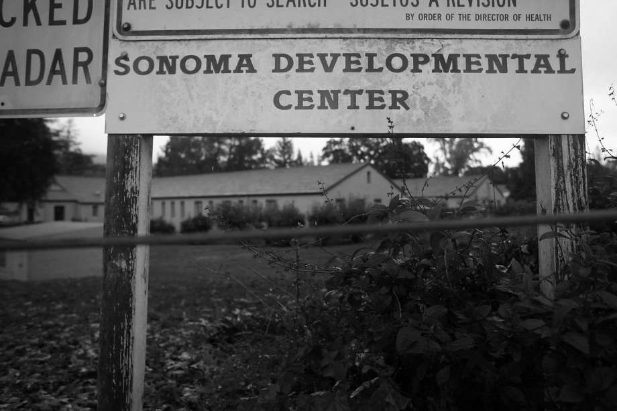
19th Century: Removal, Segregation and Restriction
Notes:
Developmental Centers started in CA in 1884 with the Sonoma State Home for the Feeble-minded—which closed its doors in December 2018. San Mateo County residents were mostly placed either in the Agnews Developmental Center in Santa Clara or the Sonoma Developmental Center (shown above) in Sonoma County.
Civil Rights Litigation Led to Closure of CA’s DCs over the past 20 years, with the above Sonoma Developmental Center closing in Dec. 2018. Population in DCs has declined from a high in 1968 of 13,400 to more than 300 today. When the last DCs close, the only remaining facility will be Porterville for serious criminal convictions. Over the past two decades, the state has spent between $400K and $500K per resident to re-house the DC population, all of which was fully recovered by the sale of the land--while ignoring the housing needs of the more than 300,000 Californians who never entered the Developmental Centers.

Slide 22
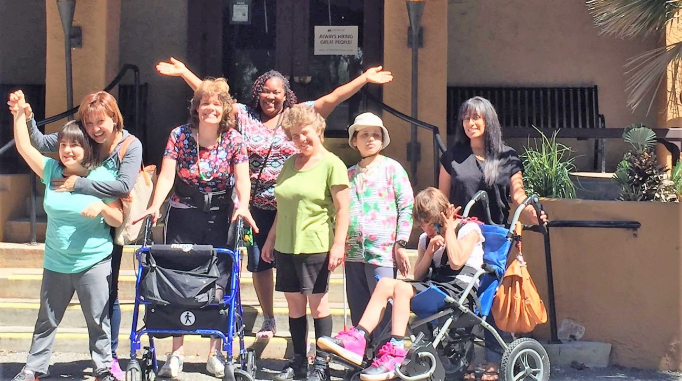
20th Century: 1968 Lanterman Act Shifts to Community-Based Services
Notes:
The Lanterman Act provided for the creation of 21 Regional Centers in 1968 to coordinate and fund community-based services designed to help people continue to live in the community and avoid institutionalization in the Developmental Centers. Licensed community facilities provided smaller segregated homes in local communities with staff, rules and regulations. But no funding for community rental housing. People can receive services to live in community rental housing but no help to pay for housing.

Slide 23

21st Century: Civil Rights, Community Services, but no Housing
Notes:
Civil rights litigation leads to closure of all Developmental Centers except Porterville—actual residents of the developmental centers were re-located to small community-based settings but no housing plan for the hundreds of thousands not living in Developmental Centers. Service waivers provide for more options for community-based services, but no plan for housing.
Federal Home and Community-Based Services (Medicaid) waiver requires re-structuring of licensed homes.
With rising home prices, some licensed home providers will simply sell out.
Already, licensed homes in San Mateo County are closing faster than new ones are opening.

Slide 24

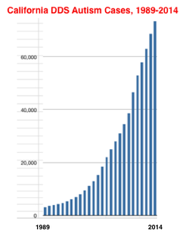
Meanwhile, a Demographic Tsunami...
Notes:
The number of people with developmental disabilities increased by 34% in San Mateo County in the decade since 2008, as a result of two continuing demographic factors.
First, this growth correlates with a significant increase in the diagnosis of children with autism that began more than 30 years ago--now seen in a dramatic increase in the number of adults entering their 30s. For example, San Mateo County now has 260% more adults with developmental disabilities in the age group 18 to 31 years compared to the age group 32 years to 41 years, representing the first wave of the autism “tsunami” that is entering adulthood. Most adults in their 20s and 30s are still living at home, but as the parents reach their 60s and 70s, they seek to find permanent supportive housing options for their adult children.
Another demographic factor contributing to the unmet housing need among people with developmental disabilities is the continuing gains in life span due to improvements in medical care and social services. For example, as recently as ten years ago, there was a 36% decrease in the San Mateo County population of adults with developmental disabilities as they aged out of the group aged 42 to 51 years and joined the group aged 52 to 61 years of age. In contrast, in December 2018, the group that is age 52 to 61 years of age is actually larger than the group that is age 42 to 51 years of age. Similarly, the number of adults living past their 62nd birthday is almost the same size as the group age 52 to 61. In just 10 years, the number of San Mateo County seniors (age 62 and older) with developmental disabilities has more than doubled.
The rate of increase would be much higher but for the fact that families with minor children with developmental disabilities are being forced out of the county in large numbers by the housing crisis. Those who remain are more likely to be families with adults because these are families who bought a home 20 or 30 years ago.

Slide 25
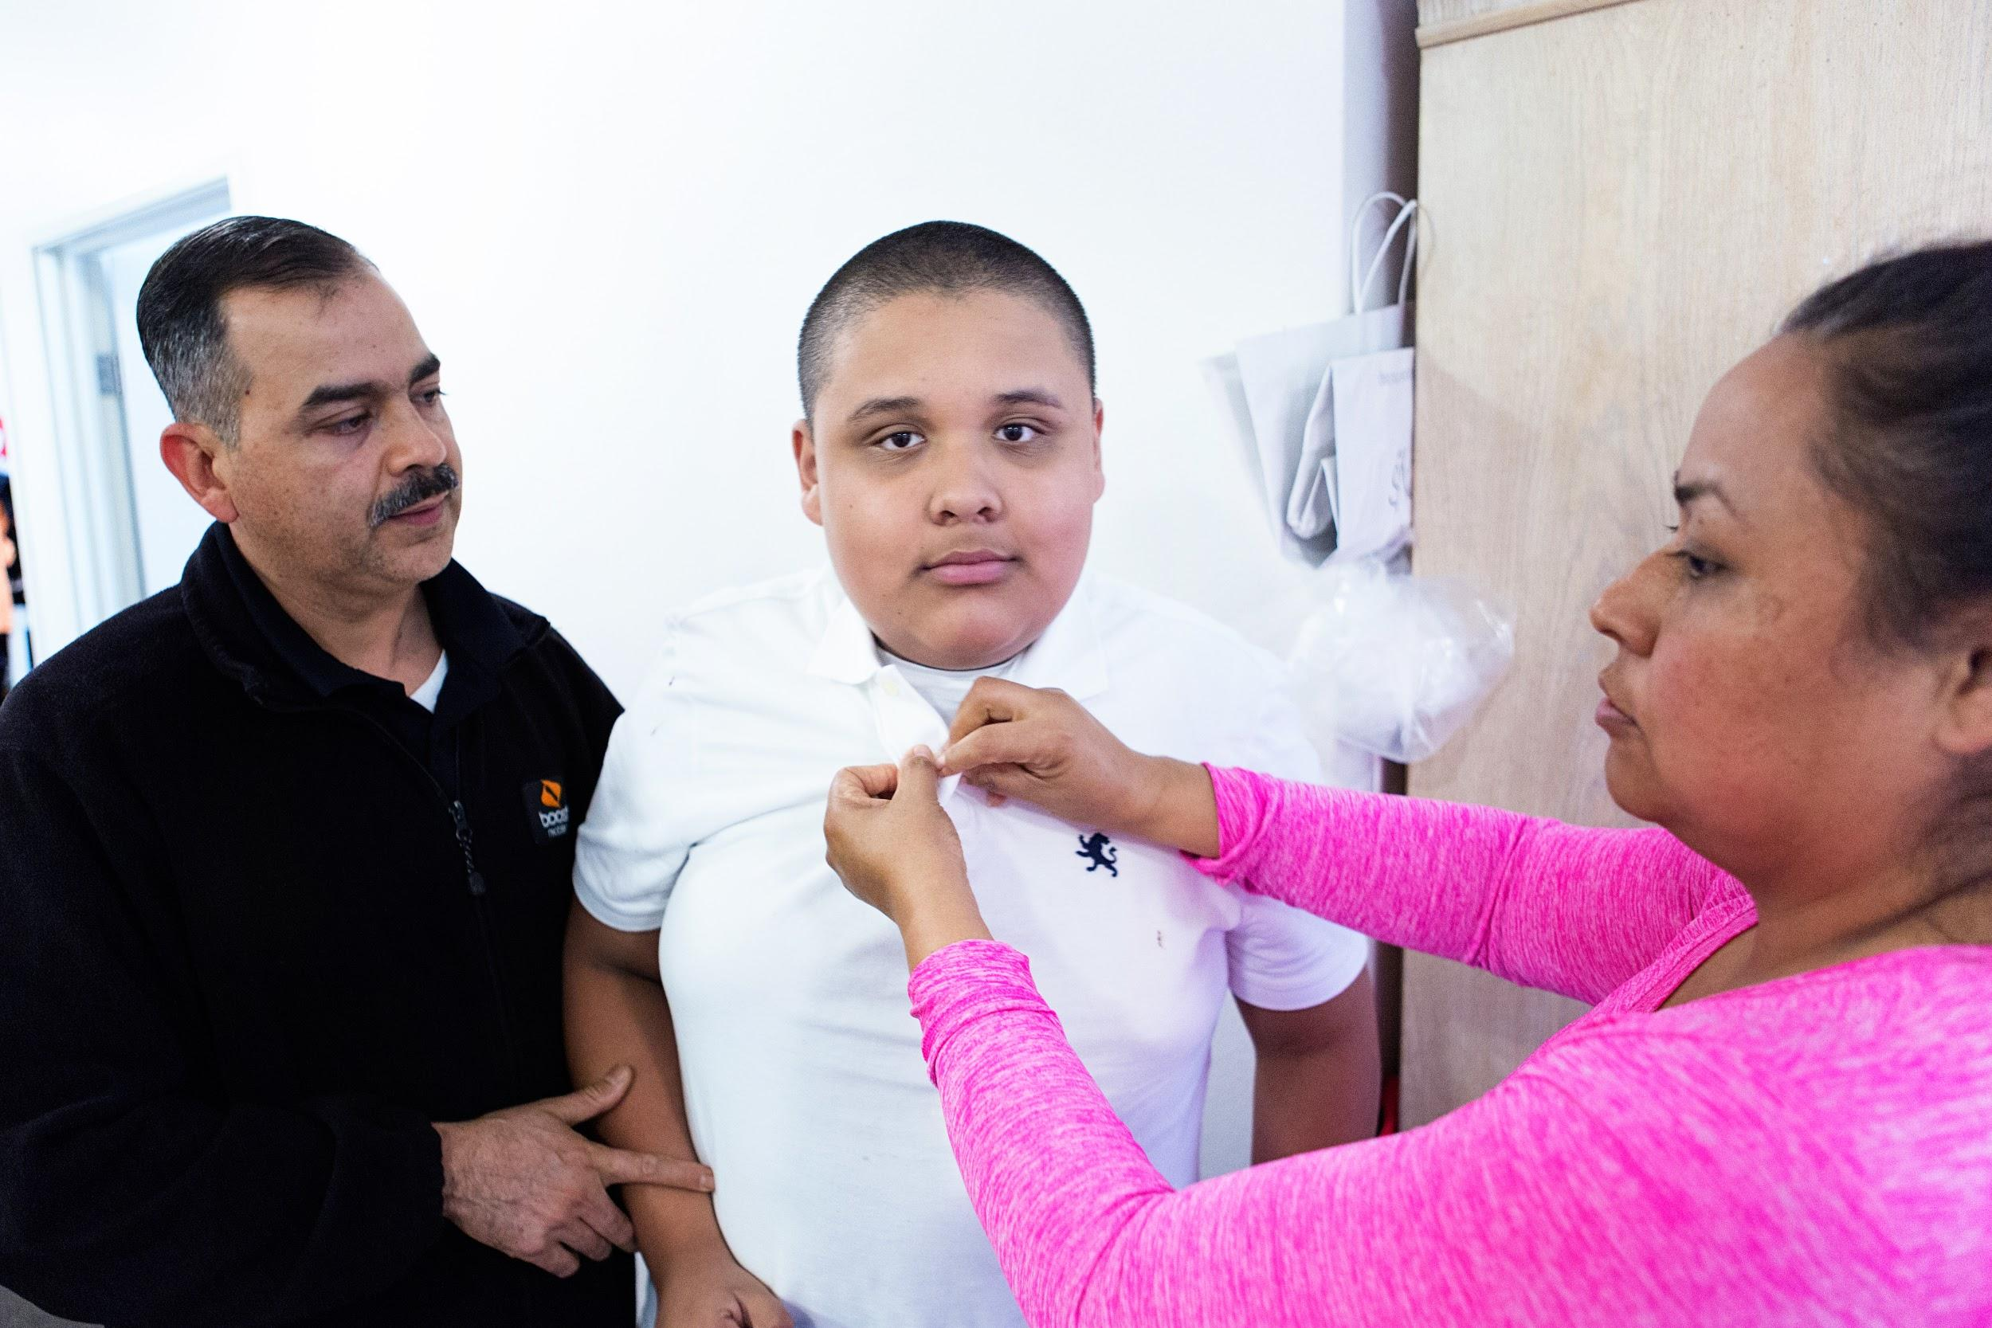
Parents Remain the Primary Housers
Notes:
More than half of the adults with developmental disabilities in San Mateo County live at home with aging parents. And this number grows every year for the reasons already discussed.
In contrast, the licensed care homes in the county are closing at a rate faster than new ones are opening. For those facilities that remain open, vacancies are fewer because of longer life spans of adults.
The housing crisis has precluded adults from moving into their own apartment, and the number living in their own apartment with Independent Living Services and Supported Living Services has been virtually static for a decade or more.
Parents of adults with developmental disabilities wonder-what happens when I reach my expiration date?

Slide 26


Housing Needs and Preferences
$$ Deep Affordability (ELI and below)
In the Communities We Know and Where We are Known
Coordinated with Services that:
Foster Housing Stability and
Provide a balance between independence and support.
Notes:
As we pursue affordable housing options for adults with developmental disabilities, what’s important to know about this community’s housing needs and preferences?

Slide 27



Housing Needs and Preferences
Close to Public Transit.
Privacy/Control of the Key to your own Home
The Ability to Choose and Change Service Providers
(without affecting control of housing).

Slide 28
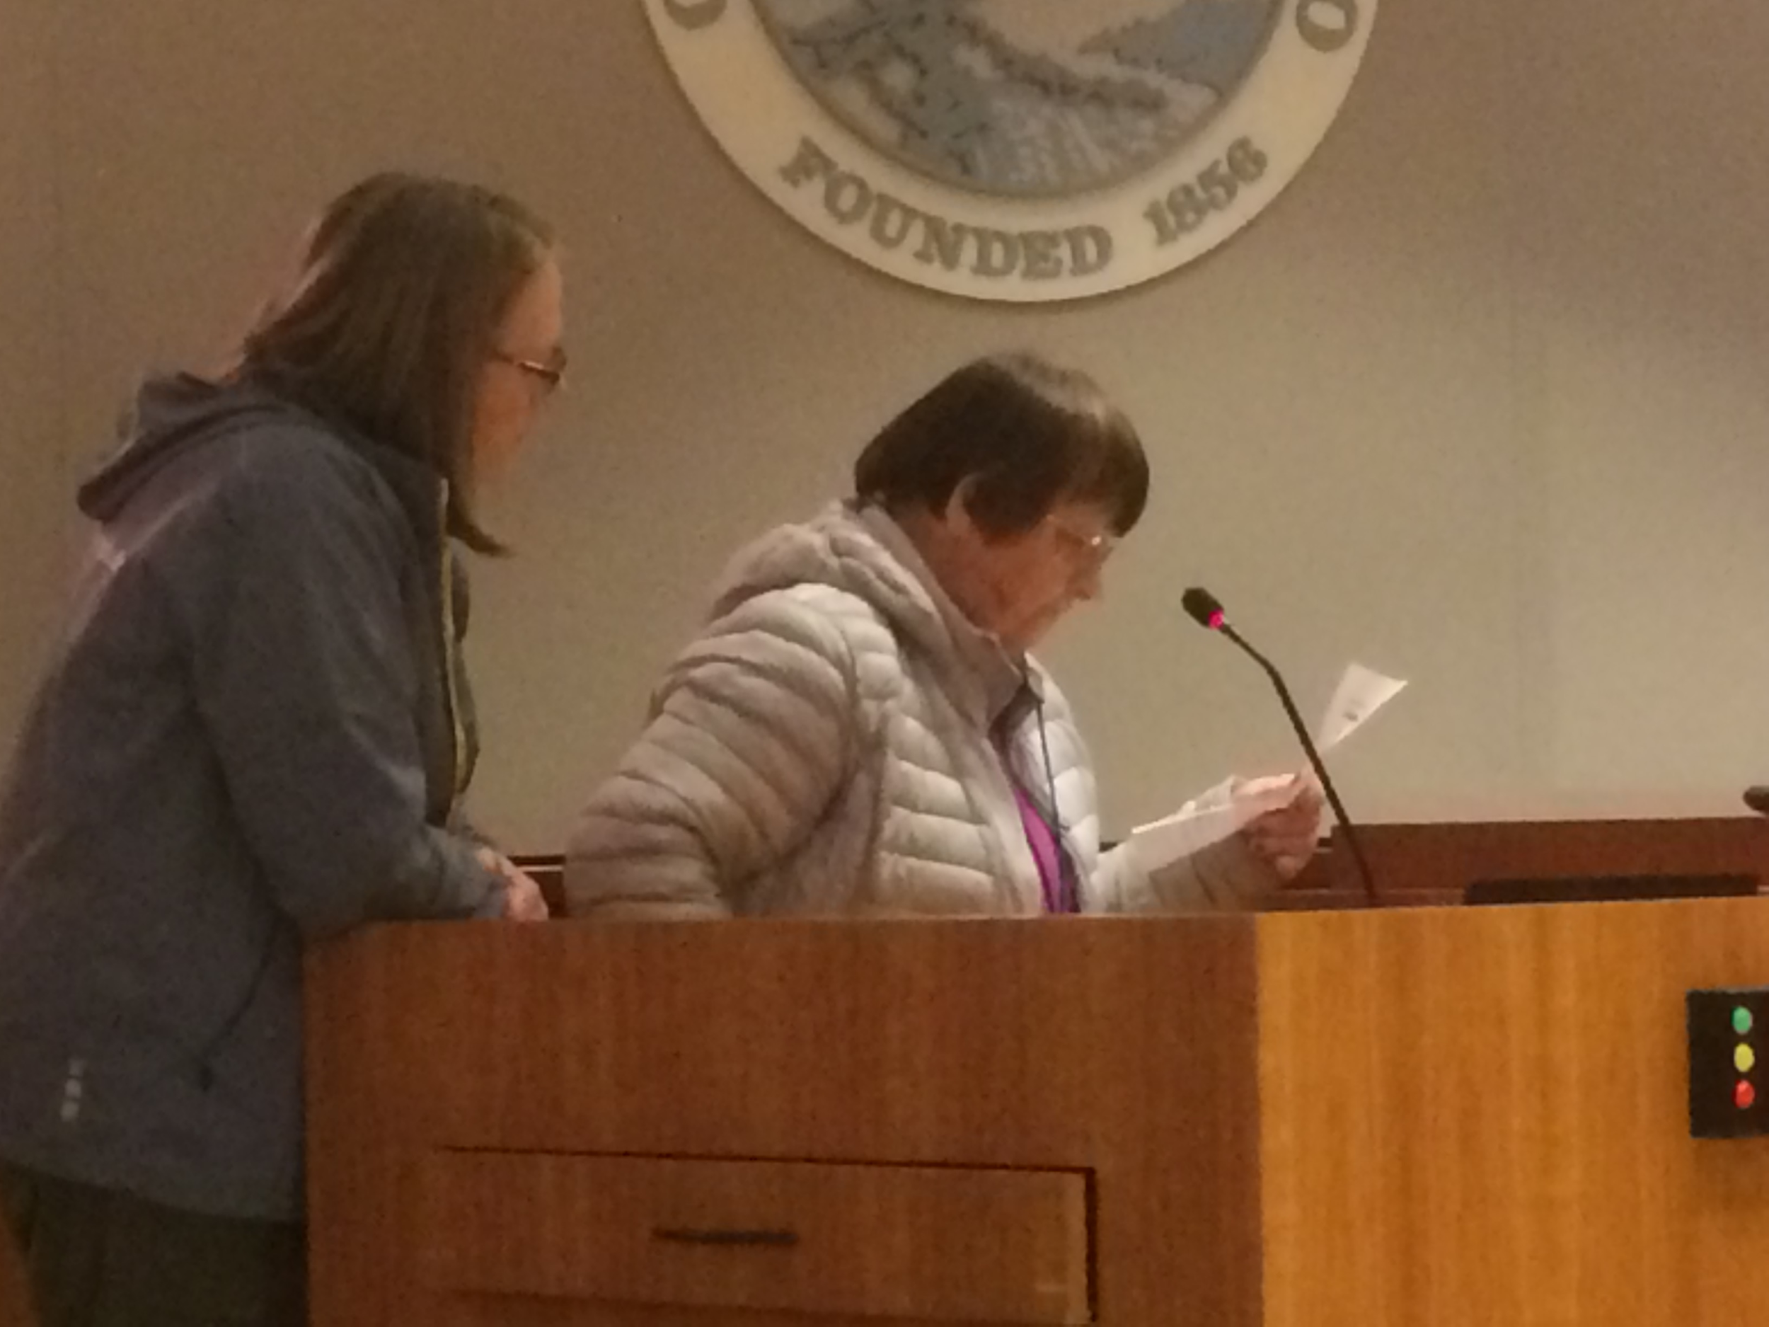
County Leadership Has Removed Barriers to Inclusion in Multi-family Affordable Housing
Notes:
Goal: Influence county and city land use and financing policies to incentivize inclusive housing for people with developmental disabilities. Our only legal handle is a section of the Government Code that requires local jurisdictions in their Housing Elements to assess and plan for the housing needs of people with developmental disabilities. Success depends on appealing to basic values about what it means to live in community.
In February 2019, the San Mateo County Board of Supervisors heard testimony from our community on the impact of excluding people with developmental disabilities from the list of special needs populations eligible for the special needs category of county housing funds--and they directed the staff to change the funding guidelines to include people with developmental disabilities who receive services from the Golden Gate Regional Center.
In March 2019, the Housing Department Director confirmed to the Board of Supervisors that the Housing Authority had to ability to award Project-Based Housing Vouchers All cities in San Mateo County have huge unmet housing needs for this population.
With this leadership from the county, cities have no reason not to include some units for people with developmental disabilities in their city-approved and funded affordable housing.
We focus our organizing on cities with parent leadership--at least two parents willing to co-chair a larger group of parents.
Parents support their adult children to participate in testifying to city council..
Parents have their own story to tell: “I have an expiration date”

Slide 29
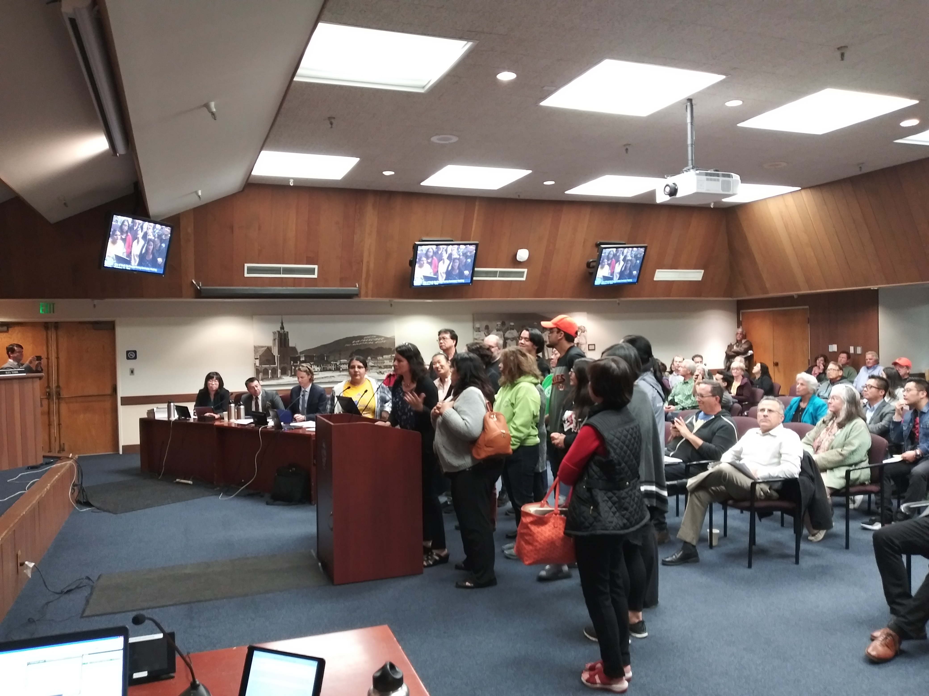
Now, Cities Are Key to Inclusion
Notes:
Inclusion in Multi-family housing: What is it?
Up to 25% of the rental units subject to a preference for adults with developmental disabilities who received coordinated services from the Regional Center. We provide a housing support staff at the property, and each resident has their own individual ILS or SLS provider.
We need ELI units the most, preferably coordinated with an award of Project Based Vouchers.
The above drawing is Firehouse Square in Belmont, where Mid-Pen Housing will make 8 apartments of 66 affordable apartments, subject to a preference for people with developmental disabilities. This is the housing strategy that we are organizing families to advocate for in San Mateo County.
Every community has

Slide 30
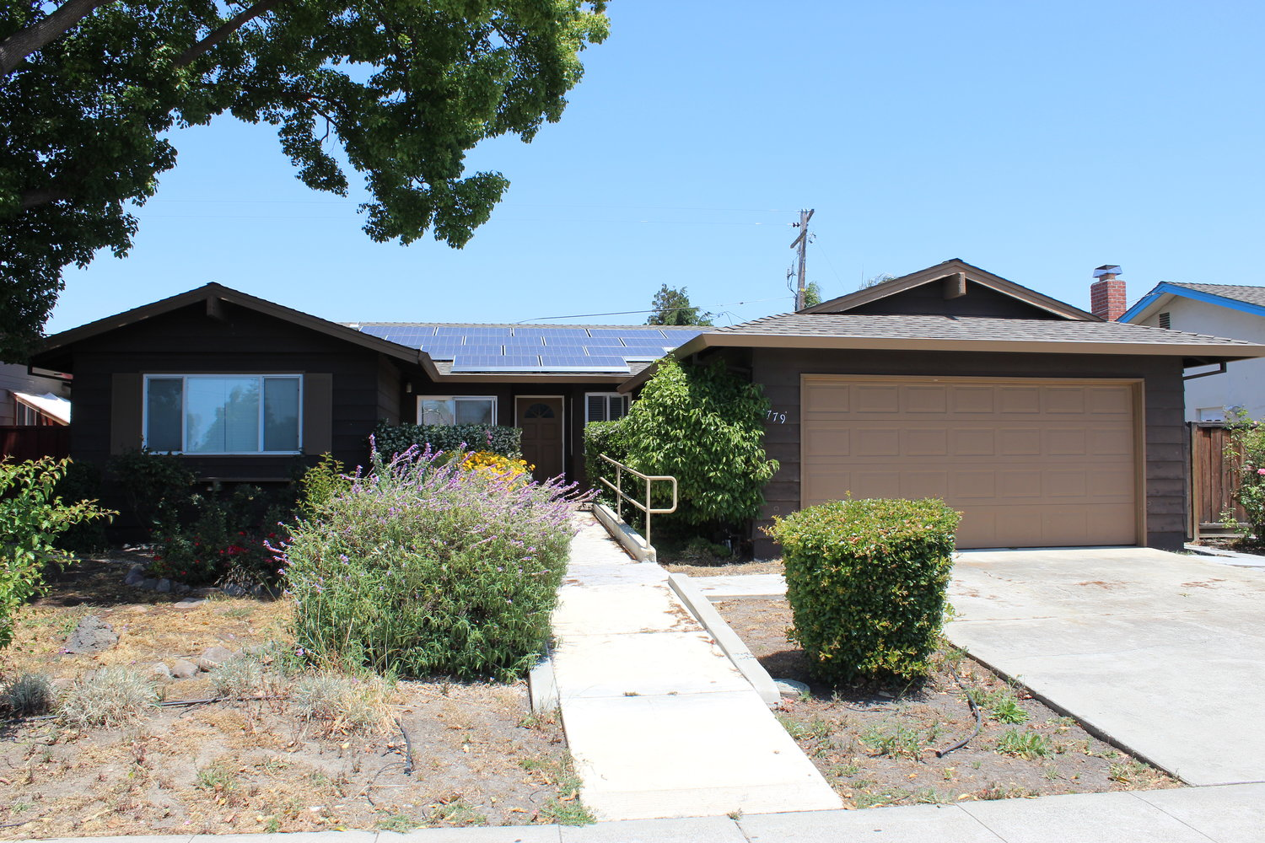
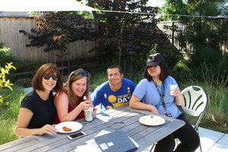
Single-Family Neighborhood Options: Co-op Housing (shared single family home)
Notes:
What is a Co-op: Shared housing (co-op) owned and managed by a nonprofit landlord:
Each resident rents a Private Bedroom--no live-in staff
Shares Common Space and Common Space Chores
Can choose and change his or her own Independent Living Services worker.
Barriers to Creating this Kind of Housing
Market price of single family homes in San Mateo County
The Rents our residents can pay don’t support debt service

Slide 31
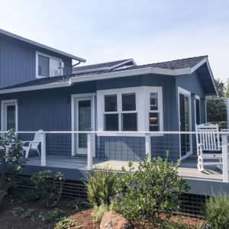
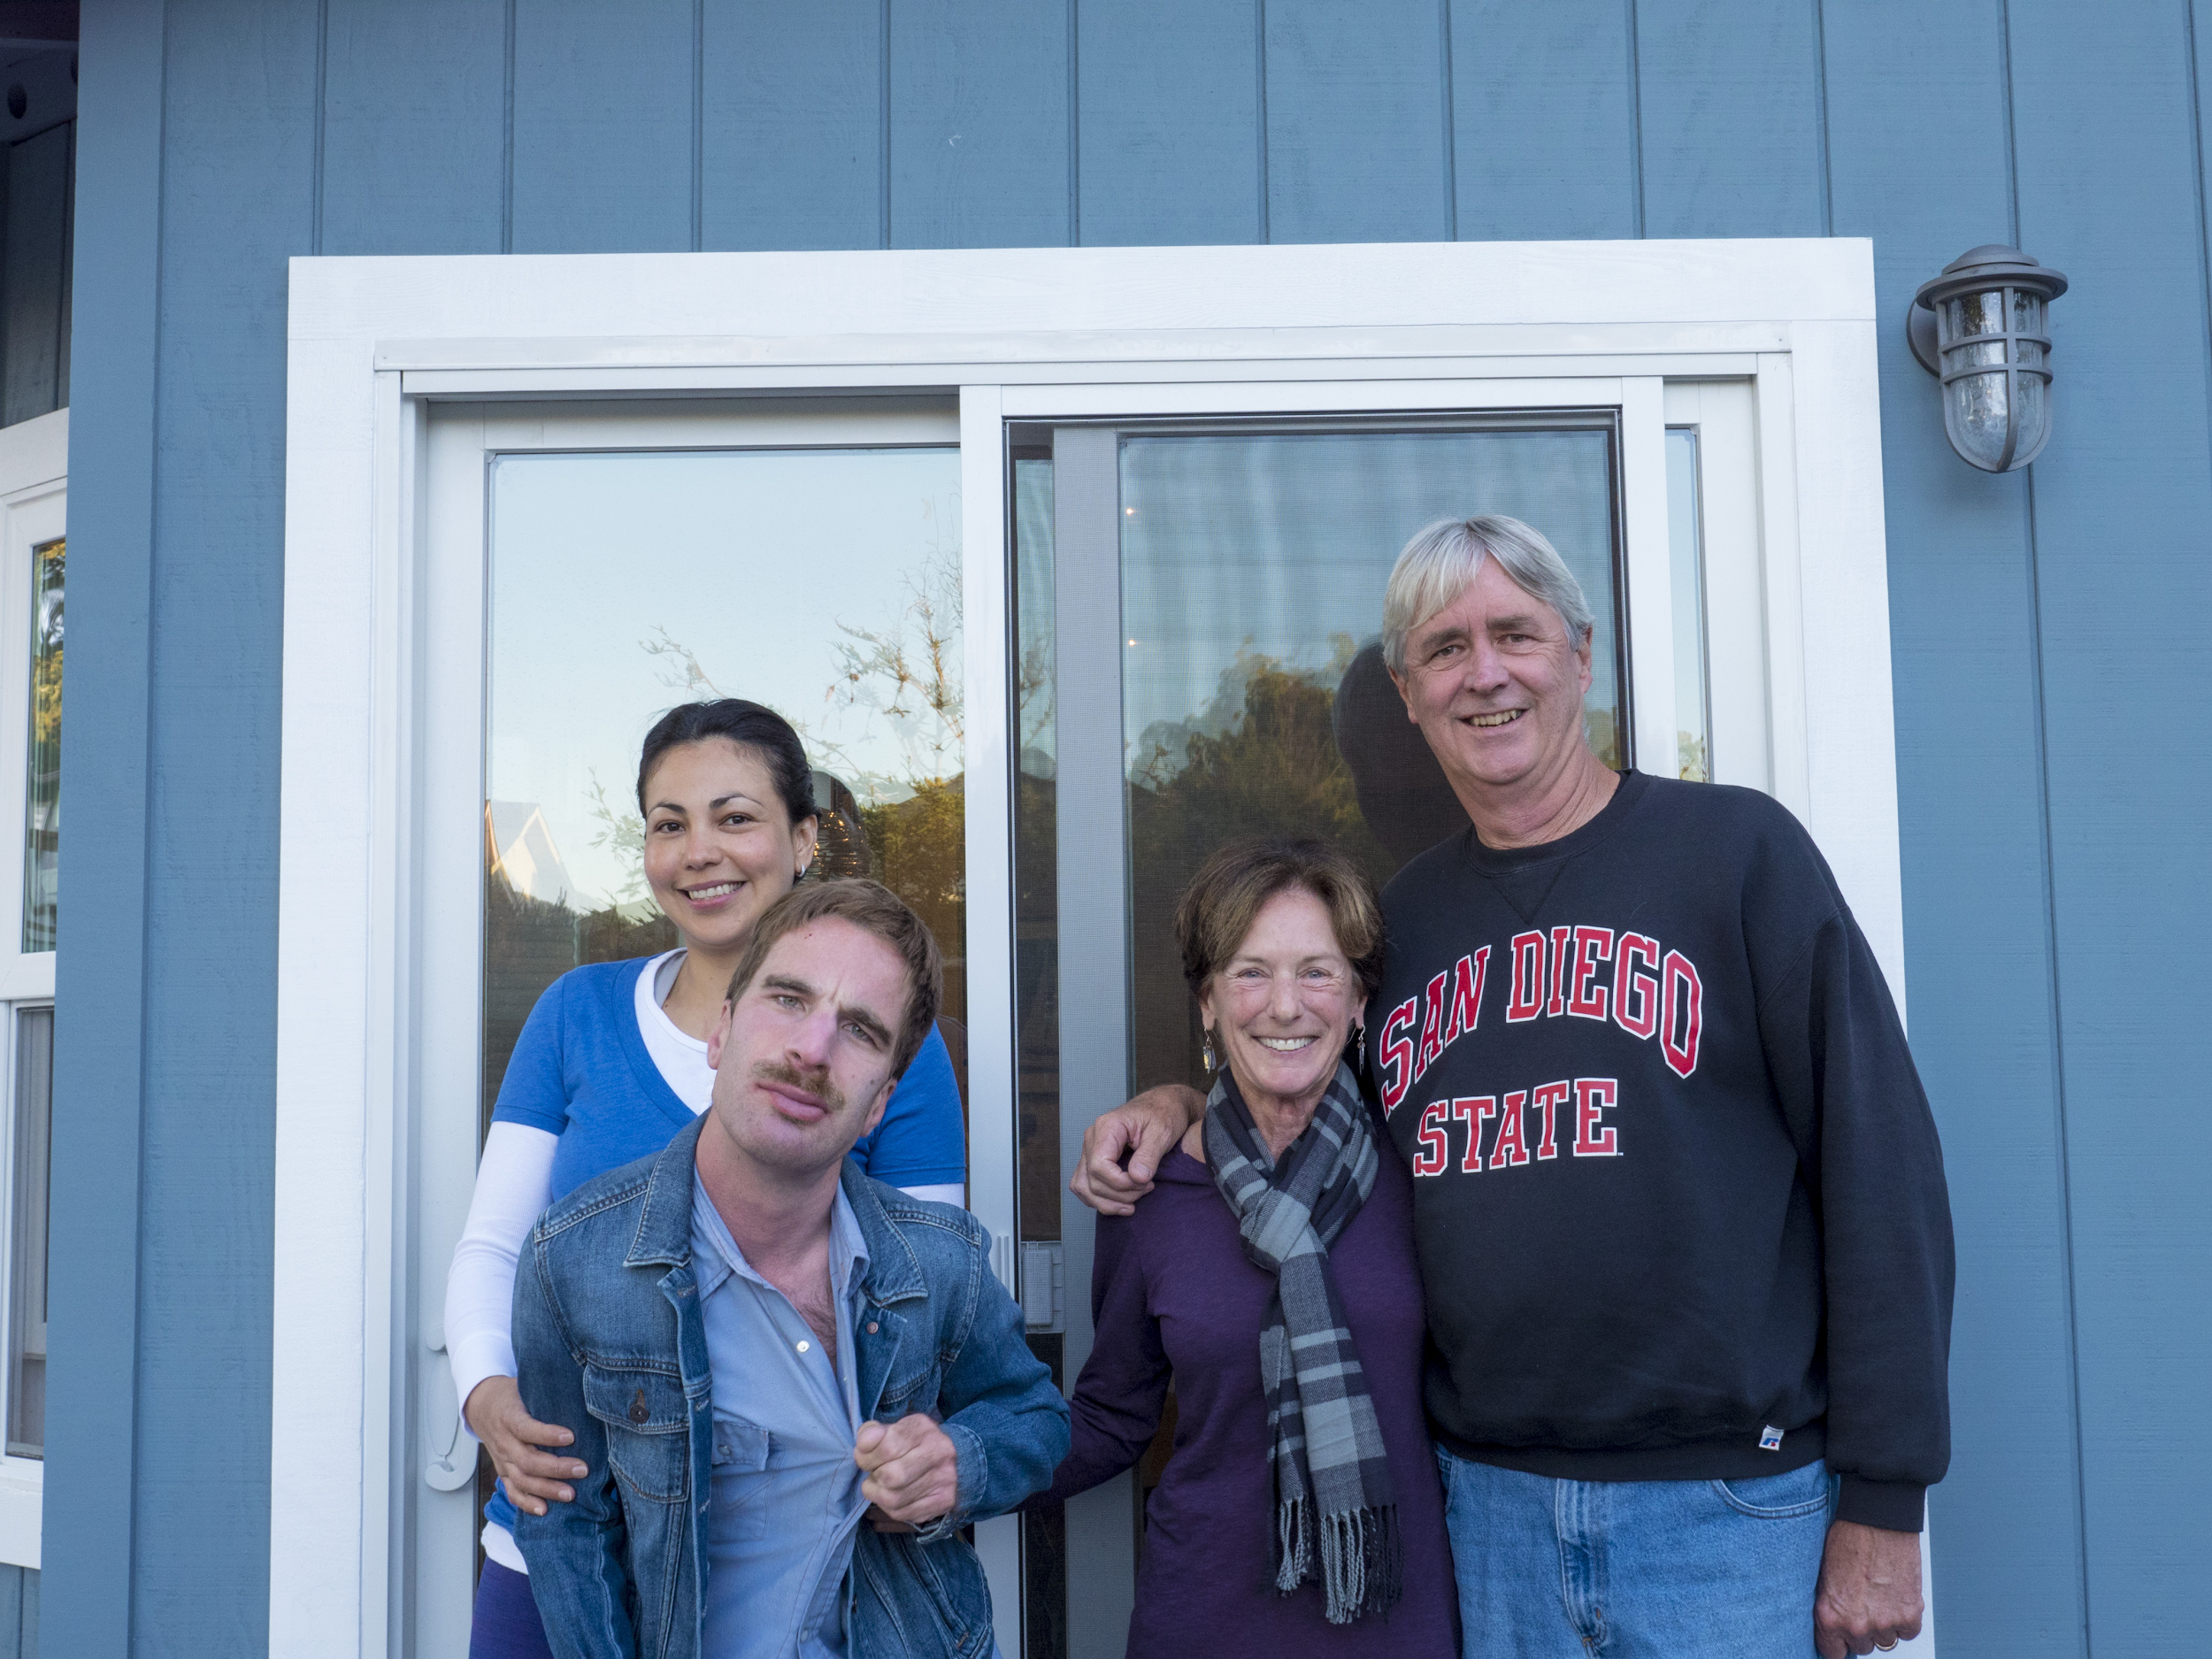
Single-Family Neighborhoods: ADUs
Notes:
What is an ADU?
Why are Families of Adults with DD considering Accessory dwelling units.
Family already owns the asset.
A way to transition to more independence in the neighborhood the person knows.
Parents can step up or step back when needed
Parents can live either in ADU or main home
When parents pass on, one of the units will create rental income to help maintain the property
Barriers:
Most families are not homeowners--don’t have this option.
State is removing many land use barriers

Slide 32
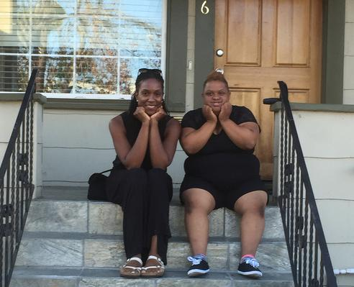
Single-Family Neighborhoods: FHA homes
Notes:
What is FHA Home: Single family homeowner serves as a foster family for an adult:
Provides a bedroom to an adult with developmental disabilities
Receives monthly stipend and support from a Family Home Agency to create successful co-living
Barriers
Finding homeowners who want to home-share.
Finding homeowners who want to home-share and support an adult with developmental disabilities

Slide 33

To Help Us Organize for Inclusive Housing in Your City…. Contact Jan Stokley jan@housingchoices.org
Learn more at www.housingchoices.org

Slide 34
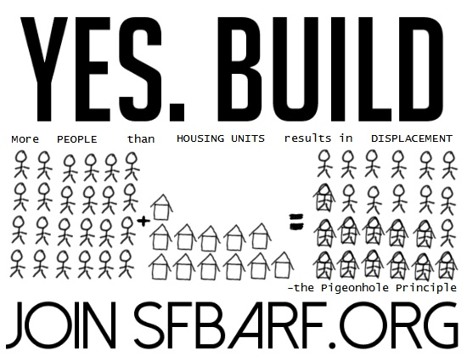
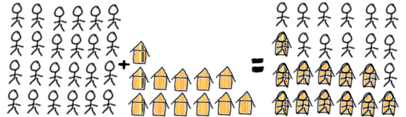

Slide 35
Housing, we need it.

Slide 36
But we don’t have it. Why?

Slide 37





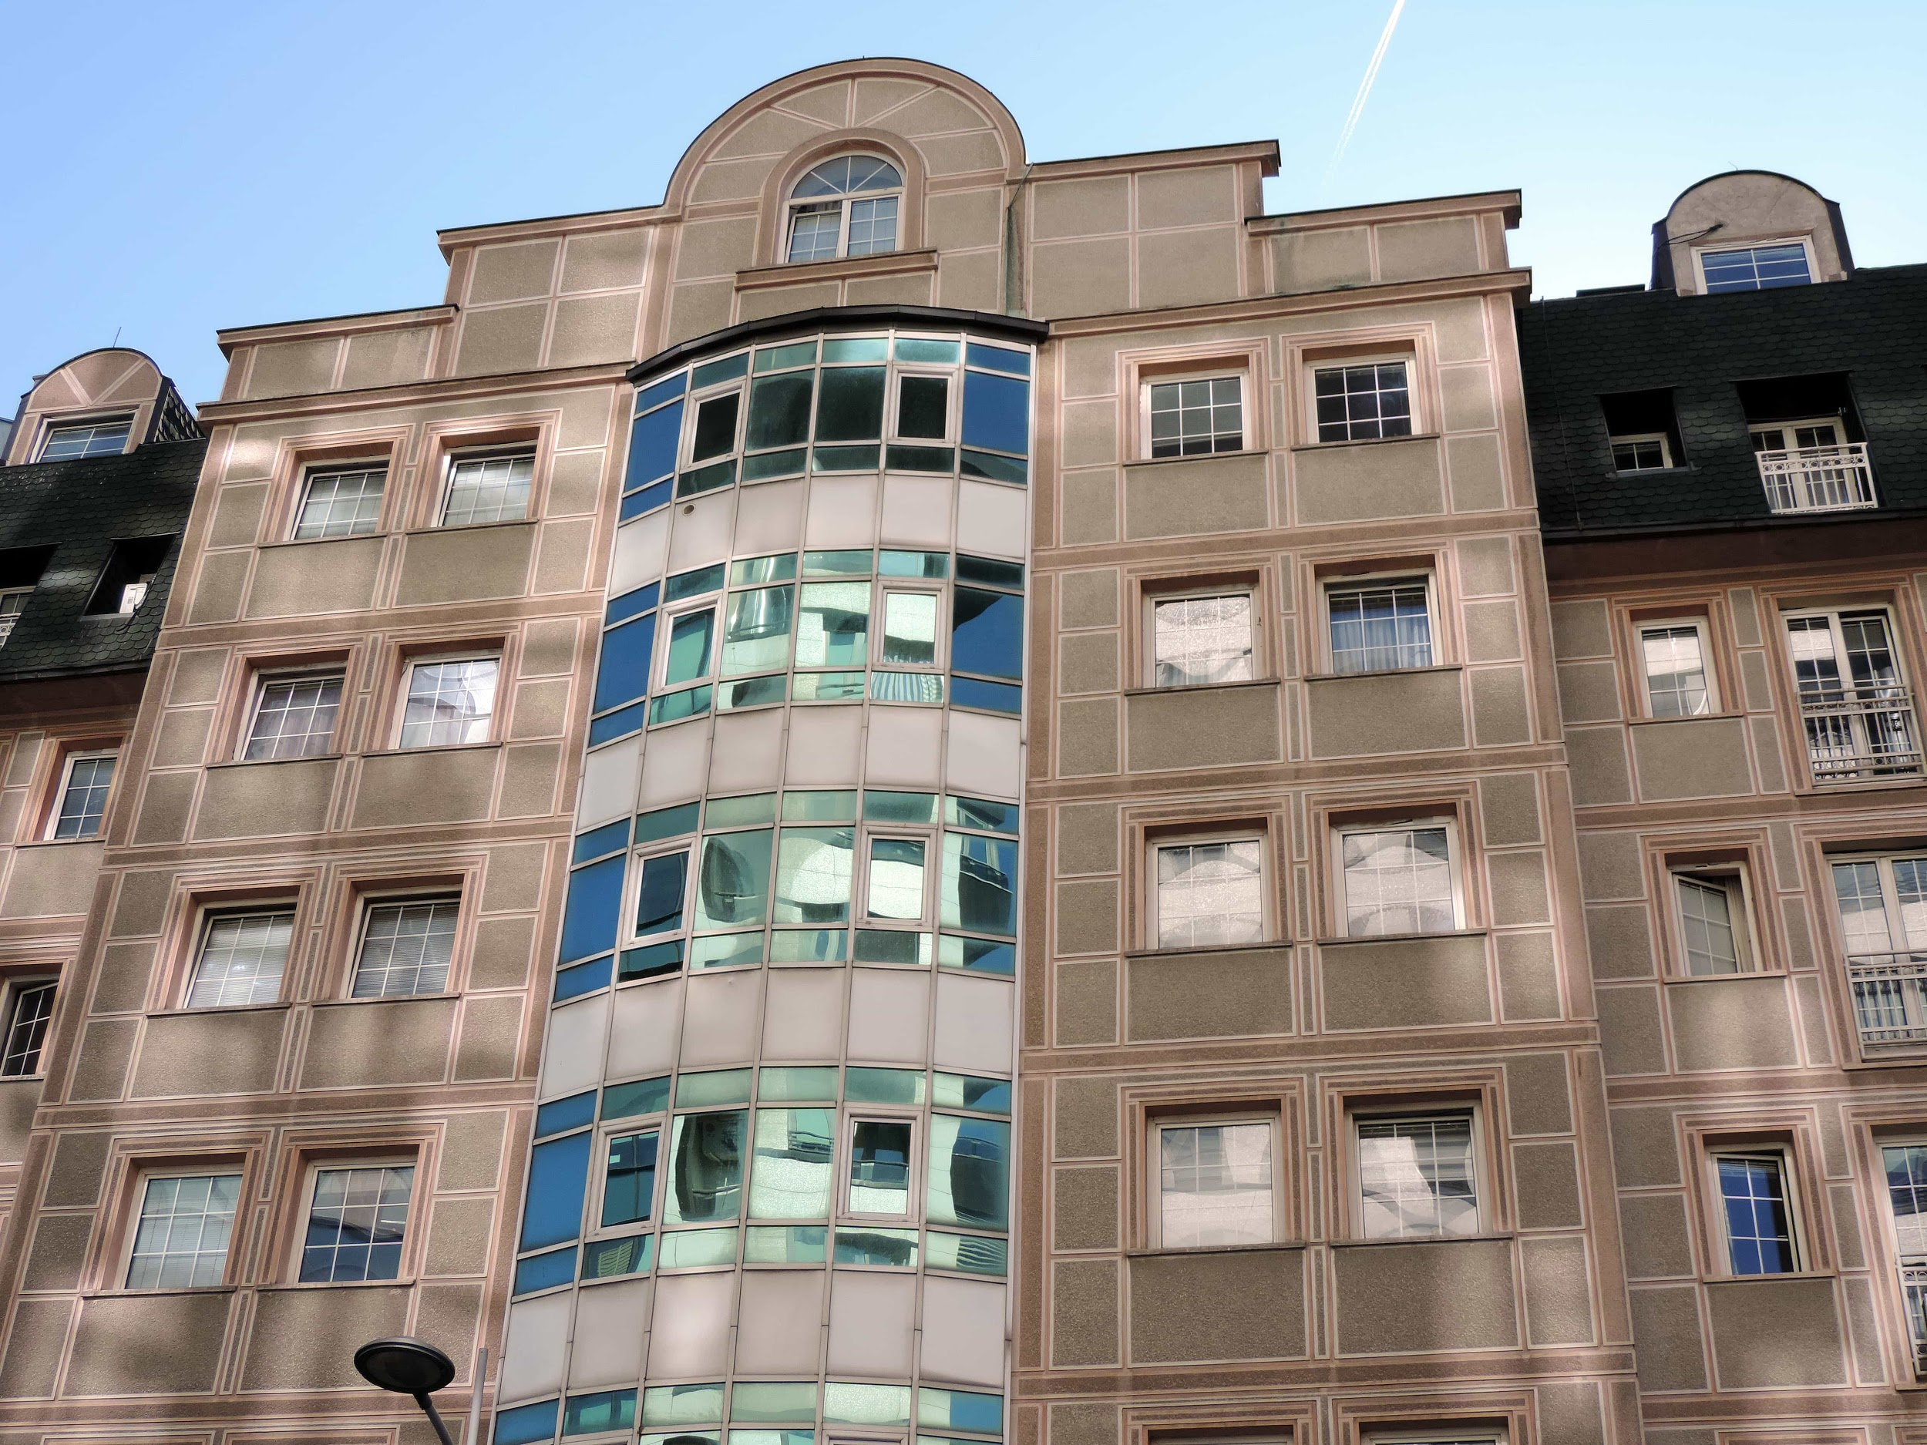


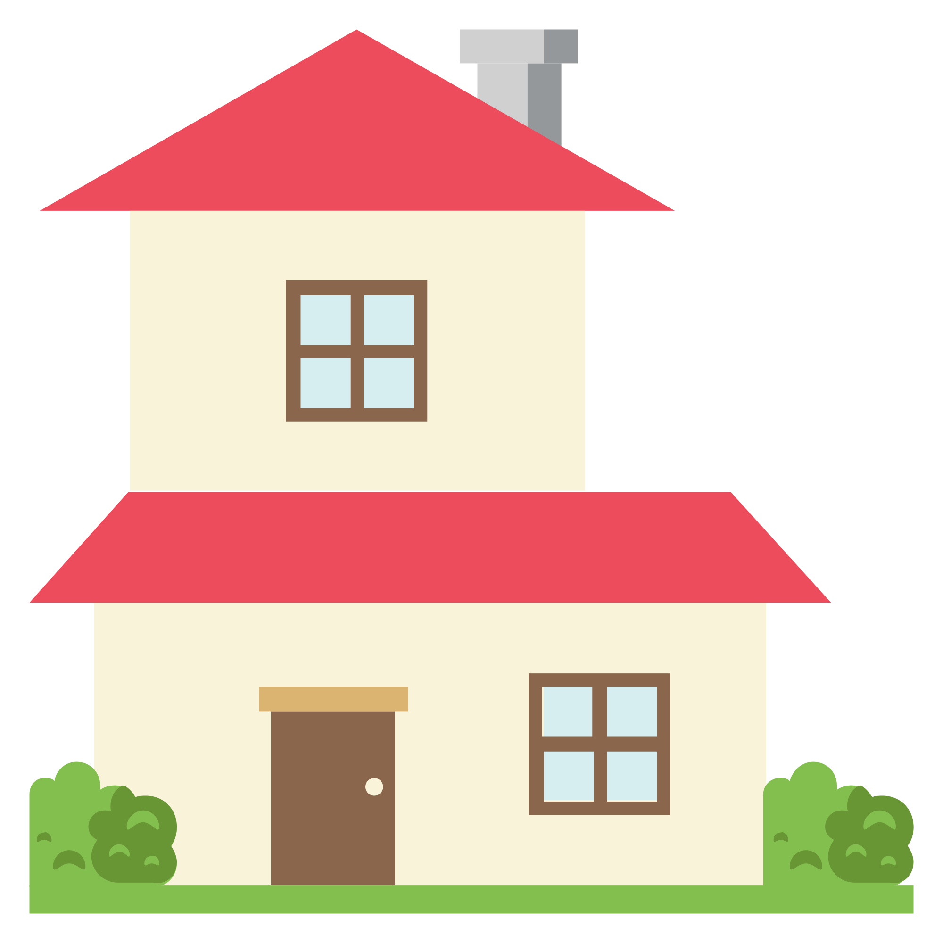

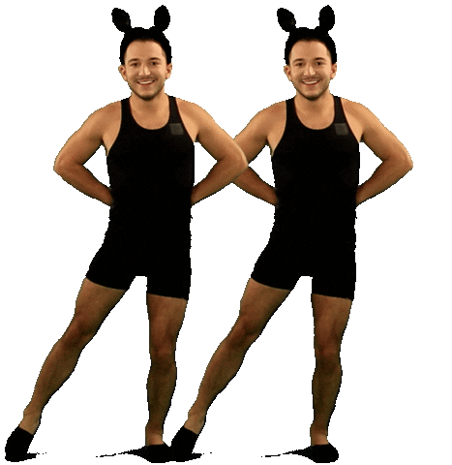






Concentrated harms, diffuse benefits

Slide 38
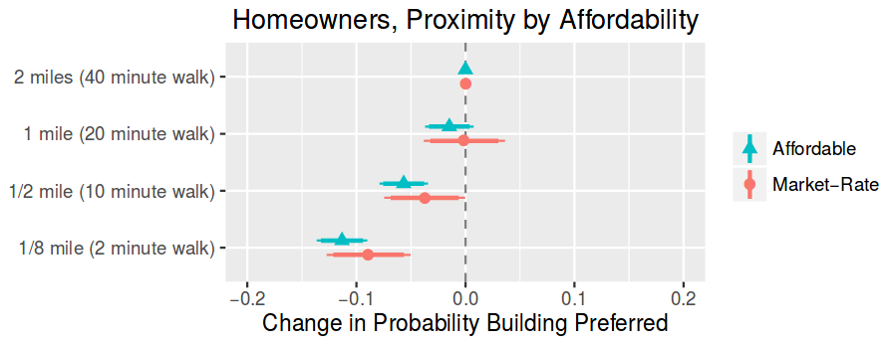


Slide 39
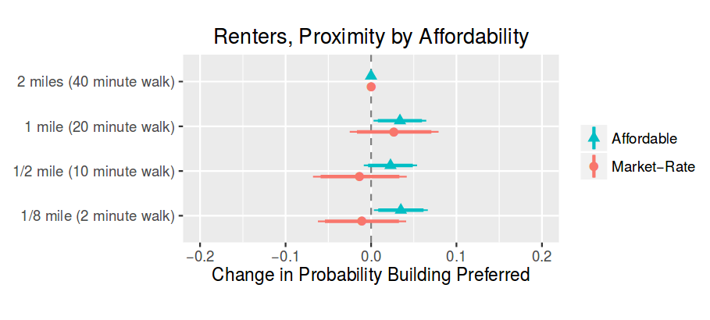

Slide 40
We make land use decisions locally

Slide 41
Most participants are homeowners

Slide 42
Locally is where homeowners don’t want housing to be!

Slide 43
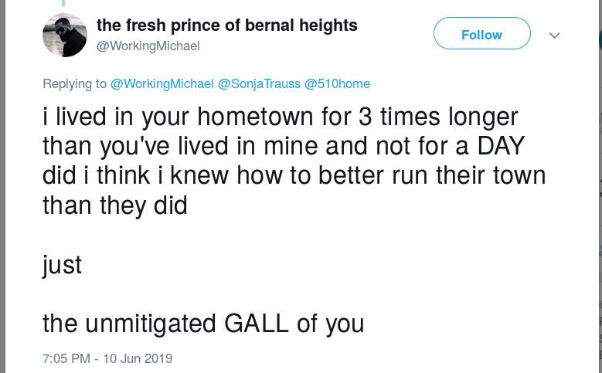

Why don’t renters participate in local decision making?

Slide 44
Law Follows Practice

Slide 45
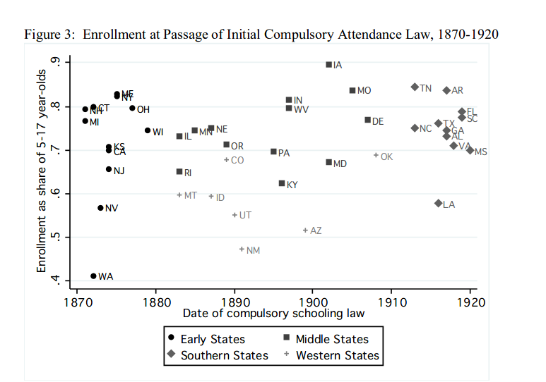
https://www.nber.org/papers/w18477.pdf

Slide 46
A process that takes renters’ interests into account
If and only if
Renters participate in the process

Slide 47
Getting Renters Involved
Look for your existing local renter groups - for example - yimbyaction.org and make sure they are notified.
DO POLLING and check your citizen feedback against the poll results.
Strong language on the agendas & speaker cards affirming that speakers don’t have to provide any personal or identifying information.
Appoint renters to your planning commissions.

Slide 48
Recognizing & Addressing
Anti-renter bias
“I’ve lived here for 35 years and …….”
Sometimes it’s obvious, “renters don’t care about the neighborhood.”
“We are excited to hear from all of our residents!”
The clerk can remind speakers not to disparage any protected groups.

Slide 49

Youth United for Community Action
Ofelia Bello, Executive Director

Slide 50

YUCA’s Mission
Youth United for Community Action (YUCA), is a grassroots community organization created, led, and run by young people of color, primarily from low-income communities.
YUCA provides a safe space for young people to empower selves and work on environmental and social justice issues to establish positive systemic change through grassroots community organizing.

Slide 51

Our Housing Work
Advocacy
Homelessness
ELI,VLI, LI Affordable Housing Production
Tenant Protections
Equitable Land Use Policies
Organizing
Tenants
Community-based Land Use Planning
Mobilizing
Young Voters & Tenant Voters
Rallies & Political Action

Slide 52
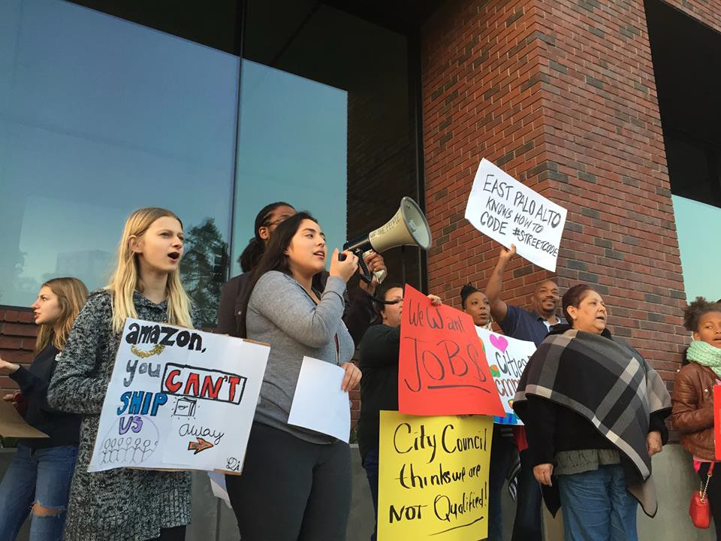
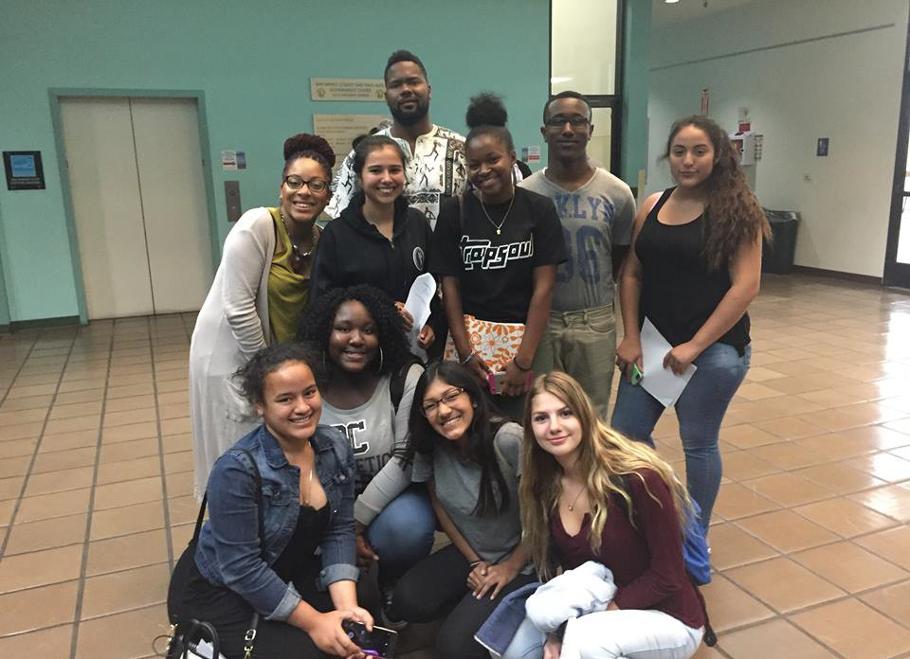
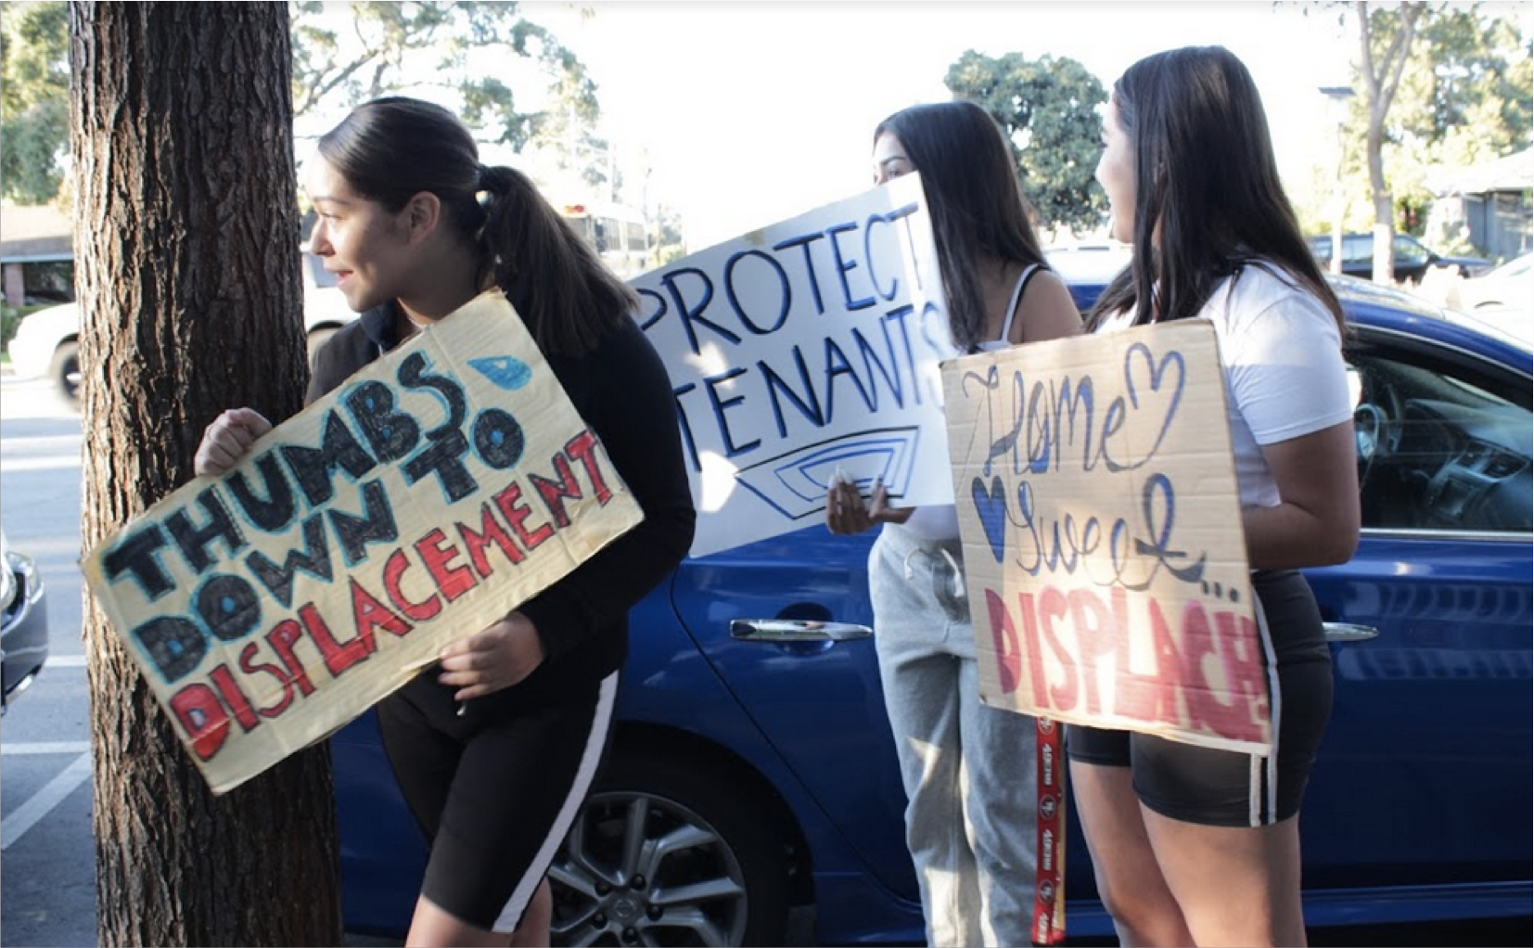
Elevating Youth Voices
Low income youth
Youth of color
Youth of immigrant backgrounds

Slide 53
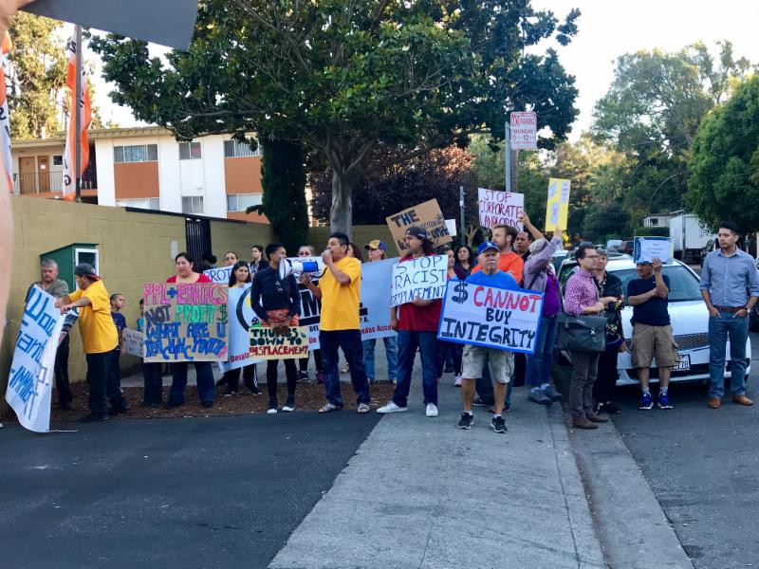
Our Partners
Renters
Long-time residents
Housing Lawyers
Organizers
Social equity planners

Slide 54
Findings & Learned Lessons
Housing Preferences:
Tenants’ rights advocacy, education and outreach is critical now
Not enough is being done to support homeless/housing insecure youth
Young people still interested in owning a home
Community-based housing solutions are particularly of interest
Youth voice is both important and impactful

Slide 55
Call to Action
Logistics matter…a lot
Democratize technical data
Outreach must be far, wide, linguistically accessible and culturally competent
Engagement doesn’t count if it doesn’t empower people

Slide 56
Thank You
Contact Ofelia Bello
ofeliabello@youthunited.net http://www.youthunited.net (650)321-9165

